Slide 1
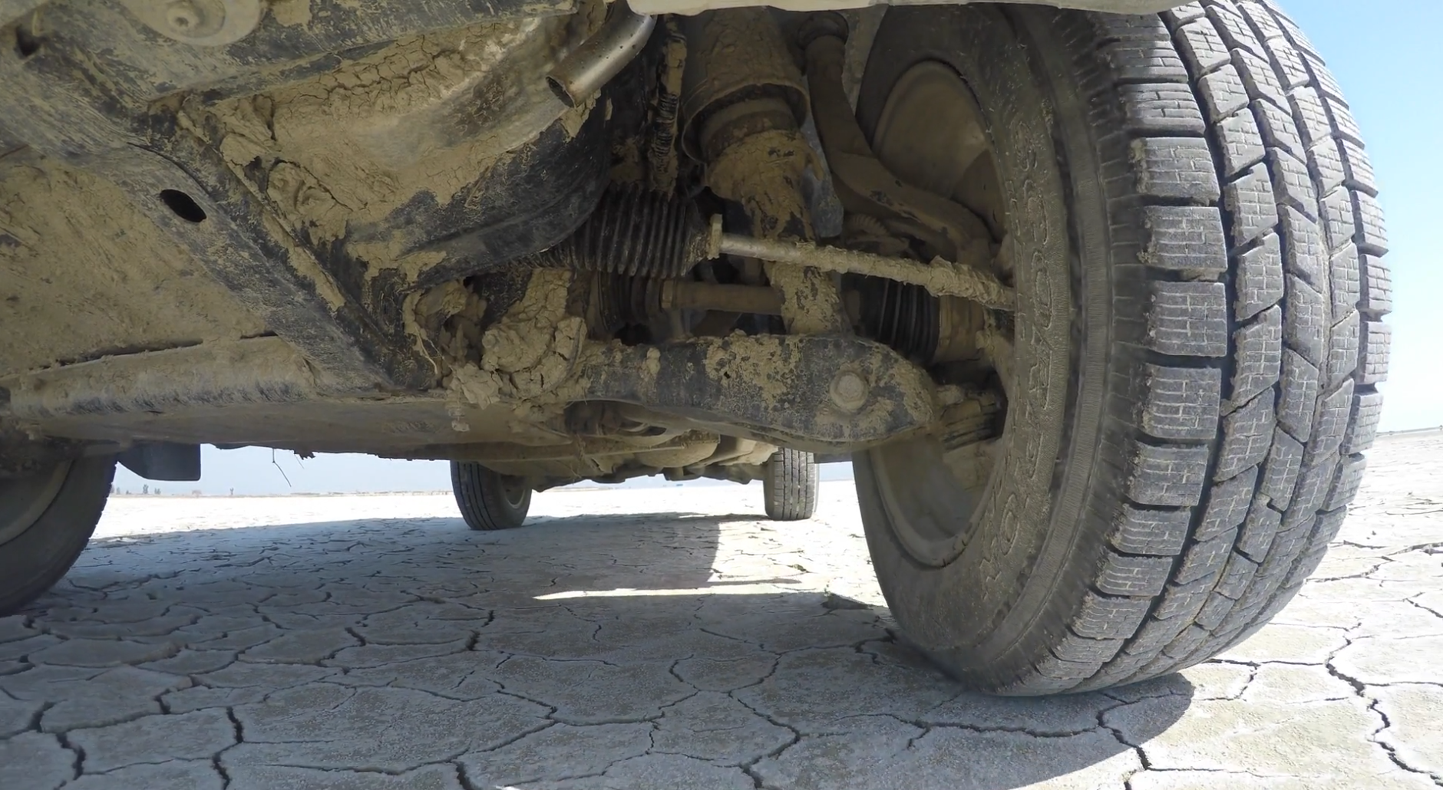
Vibration isolation
Shock and four-pole parameters
Tyler Dare

Slide 2

Shock
Response to a transient event, usually large forces over a short time.
Types of shock events:
Impact
Drop
Explosion
Earthquake
Common questions:
Will it survive?
How much damage is expected?

Slide 3
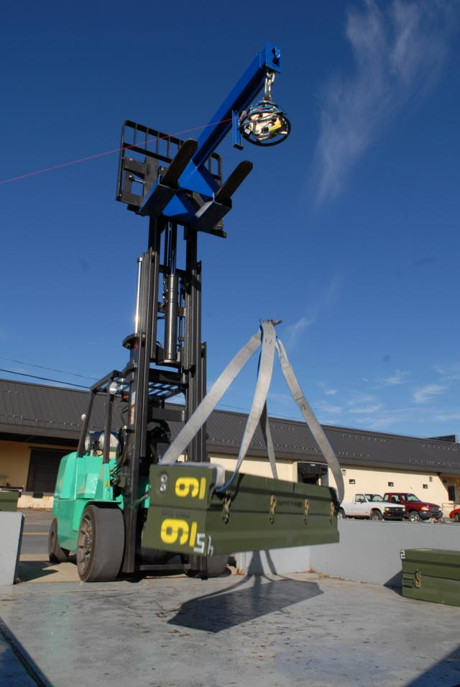

Shock testing
Create the shock event and see what happens.
Explosive shock testing
What if we cannot test all possible events?

Slide 4
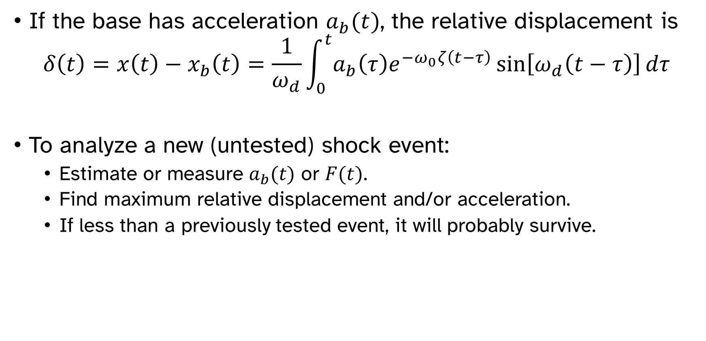
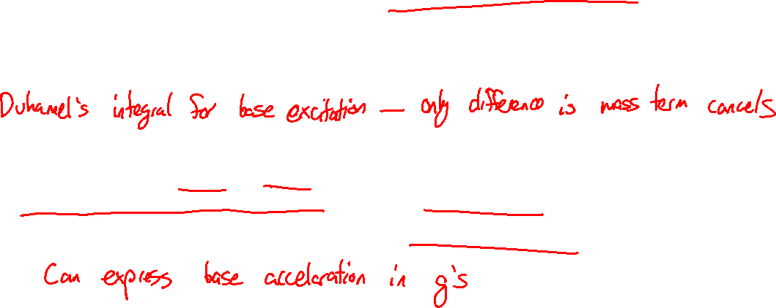
Shock response spectrum
If the base has acceleration $a_{b}(t)$, the relative displacement is
$$δ\left(t\right)=x\left(t\right)−x_{b}\left(t\right)=\frac{1}{ω_{d}}\int_{0}^{t}{a_{b}\left(τ\right)e^{−ω_{0}ζ\left(t−τ\right)}\sin\left[ω_{d}\left(t−τ\right)\right]dτ}$$
To analyze a new (untested) shock event:
Estimate or measure $a_{b}(t)$ or $F(t)$.
Find maximum relative displacement and/or acceleration.
If less than a previously tested event, it will probably survive.

Slide 5

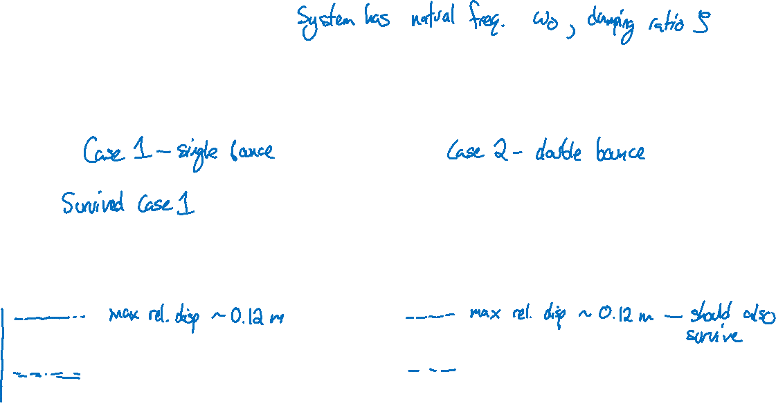
Shock response spectrum
$$δ\left(t\right)=\frac{1}{ω_{d}}\int_{0}^{t}{a_{b}\left(τ\right)e^{−ω_{0}ζ\left(t−τ\right)}\sin\left[ω_{d}\left(t−τ\right)\right]dτ}$$

Slide 6
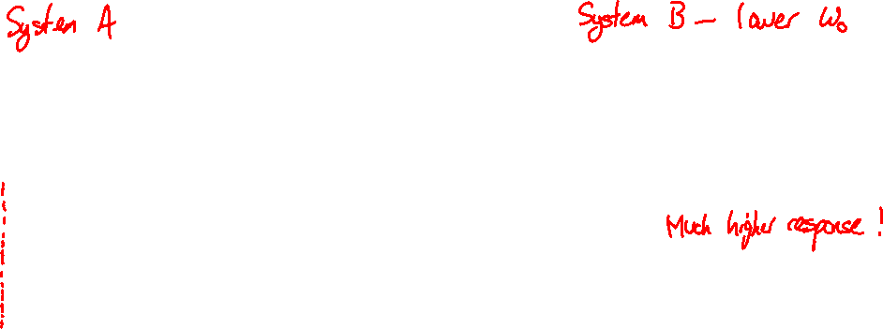
Shock response spectrum
$$δ\left(t\right)=\frac{1}{ω_{d}}\int_{0}^{t}{a_{b}\left(τ\right)e^{−ω_{0}ζ\left(t−τ\right)}\sin\left[ω_{d}\left(t−τ\right)\right]dτ}$$

Slide 7
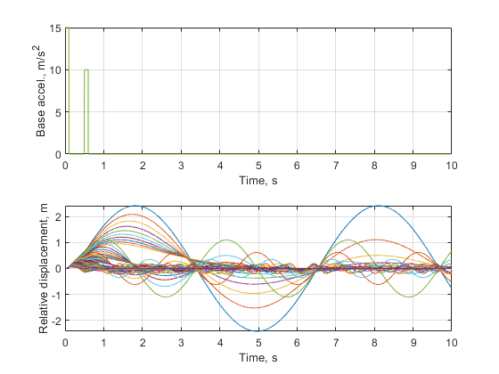
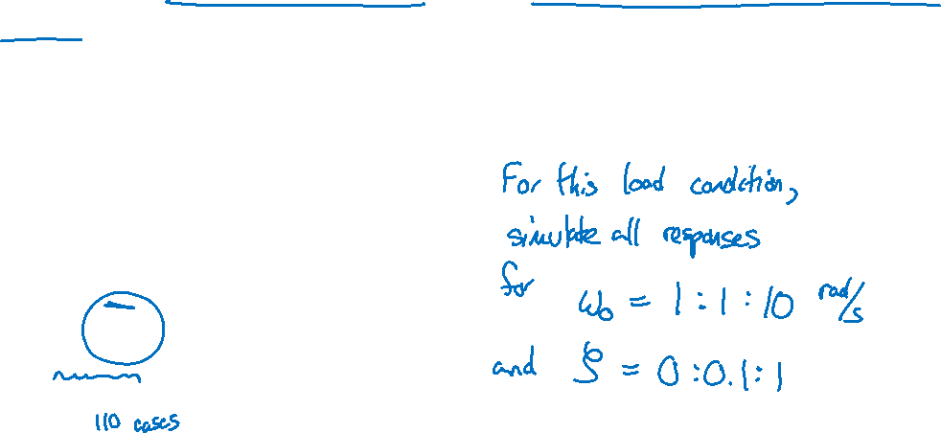
Shock response spectrum
If you have multiple systems or a system with several different modes, you can pre-calculate the response for many different damping ratios and natural frequencies.

Slide 8
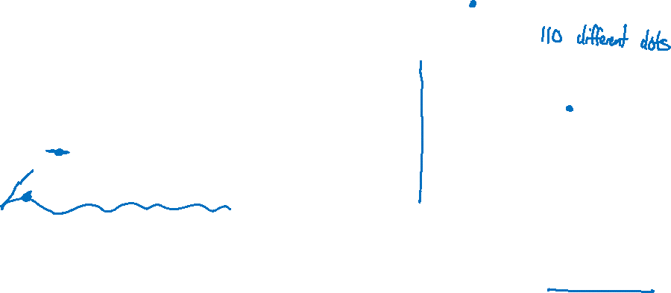
Shock response spectrum
Calculate the maximum response for each simulation to produce the “shock response spectrum” for that loading condition.

Slide 9
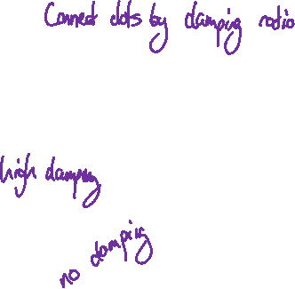
Shock response spectrum
Calculate the maximum response for each simulation to produce the “shock response spectrum” for that loading condition.

Slide 10
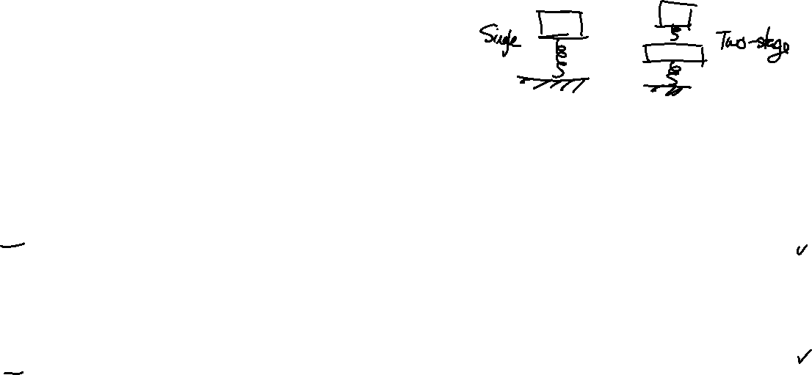
Shock response spectrum
Example: Two different mounts are candidates for a machine. For both mounts, the machine survives shock testing under load condition A. Which mount will most likely also survive load condition B?
Single-stage mount
A
Natural freq. | Damping ratio
13 | 0.02
Two-stage mount
B
Natural freq. | Damping ratio
12 | 0.1
14 | 0.1

Slide 11
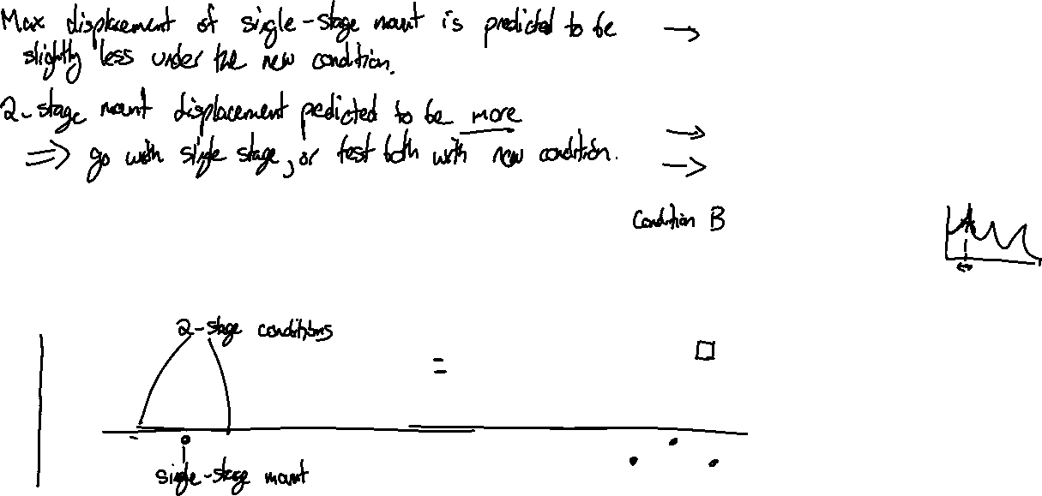
Shock response spectrum
Single-stage mount
Natural freq. | Damping ratio
13 | 0.02
Two-stage mount
Natural freq. | Damping ratio
12 | 0.1
14 | 0.1

Slide 12
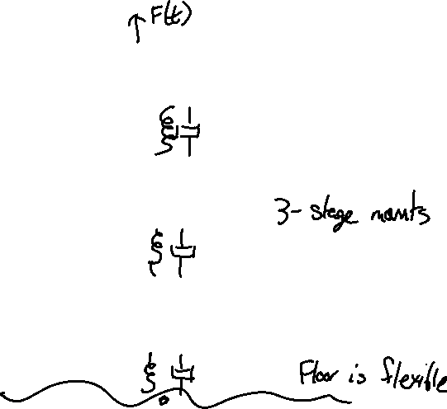
Building up complex systems
Machine
Raft 1
Raft 2

Slide 13
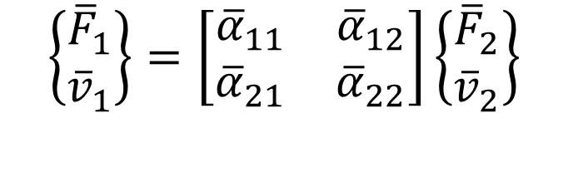
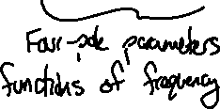
Four pole parameters for vibrations
Similar to four pole parameters for duct acoustics
Useful when combining multiple systems together
$$\left\{\begin{matrix}{\overline{F}}_{1} \\ {\overline{v}}_{1}\end{matrix}\right\}=\left[\begin{matrix}{\overline{α}}_{11} & {\overline{α}}_{12} \\ {\overline{α}}_{21} & {\overline{α}}_{22}\end{matrix}\right]\left\{\begin{matrix}{\overline{F}}_{2} \\ {\overline{v}}_{2}\end{matrix}\right\}$$

Slide 14
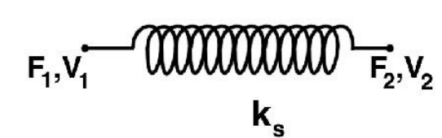
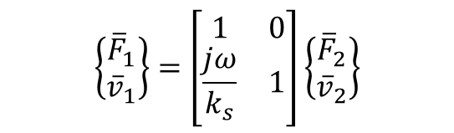
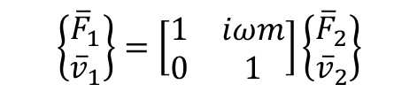



Four pole parameters for vibrations
$$\left\{\begin{matrix}{\overline{F}}_{1} \\ {\overline{v}}_{1}\end{matrix}\right\}=\left[\begin{matrix}1 & 0 \\ \frac{jω}{k_{s}} & 1\end{matrix}\right]\left\{\begin{matrix}{\overline{F}}_{2} \\ {\overline{v}}_{2}\end{matrix}\right\}$$
$$\left\{\begin{matrix}{\overline{F}}_{1} \\ {\overline{v}}_{1}\end{matrix}\right\}=\left[\begin{matrix}1 & 0 \\ \frac{1}{C} & 1\end{matrix}\right]\left\{\begin{matrix}{\overline{F}}_{2} \\ {\overline{v}}_{2}\end{matrix}\right\}$$
$$C$$
$$\left\{\begin{matrix}{\overline{F}}_{1} \\ {\overline{v}}_{1}\end{matrix}\right\}=\left[\begin{matrix}1 & iωm \\ 0 & 1\end{matrix}\right]\left\{\begin{matrix}{\overline{F}}_{2} \\ {\overline{v}}_{2}\end{matrix}\right\}$$
$$m$$

Slide 15
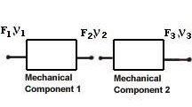
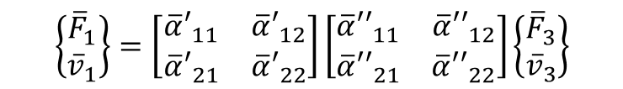
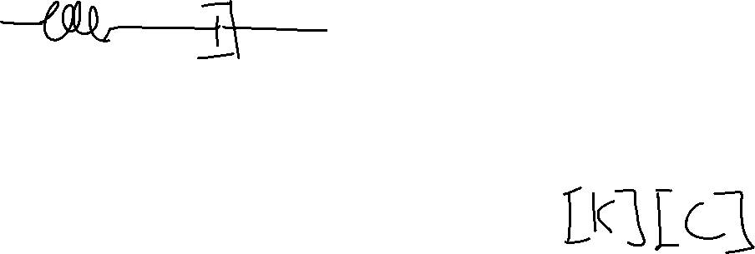
Four pole parameters for vibrations
$$\left\{\begin{matrix}{\overline{F}}_{1} \\ {\overline{v}}_{1}\end{matrix}\right\}=\left[\begin{matrix}{\overline{α}′}_{11} & {\overline{α}′}_{12} \\ {\overline{α}′}_{21} & {\overline{α}′}_{22}\end{matrix}\right]\left[\begin{matrix}{\overline{α}′′}_{11} & {\overline{α}′′}_{12} \\ {\overline{α}′′}_{21} & {\overline{α}′′}_{22}\end{matrix}\right]\left\{\begin{matrix}{\overline{F}}_{3} \\ {\overline{v}}_{3}\end{matrix}\right\}$$

Slide 16
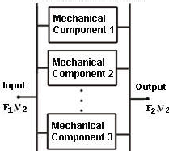
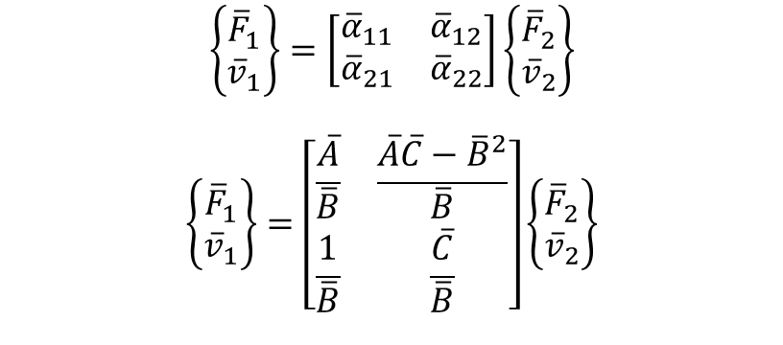
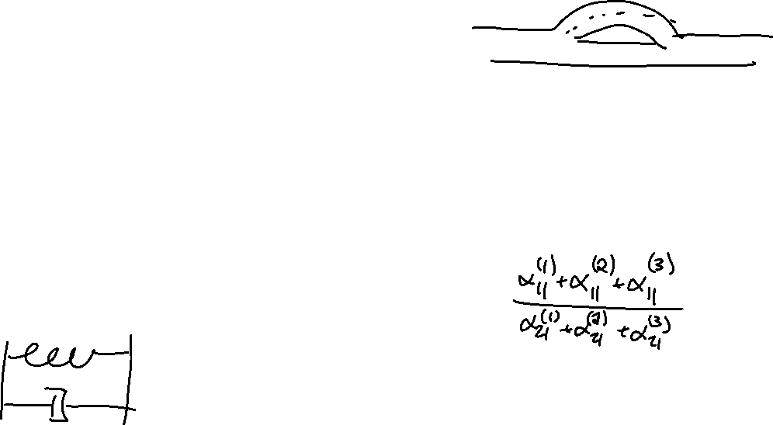

Four pole parameters for vibrations
$$\left\{\begin{matrix}{\overline{F}}_{1} \\ {\overline{v}}_{1}\end{matrix}\right\}=\left[\begin{matrix}{\overline{α}}_{11} & {\overline{α}}_{12} \\ {\overline{α}}_{21} & {\overline{α}}_{22}\end{matrix}\right]\left\{\begin{matrix}{\overline{F}}_{2} \\ {\overline{v}}_{2}\end{matrix}\right\}$$
$$\left\{\begin{matrix}{\overline{F}}_{1} \\ {\overline{v}}_{1}\end{matrix}\right\}=\left[\begin{matrix}\frac{\overline{A}}{\overline{B}} & \frac{\overline{A}\overline{C}−{\overline{B}}^{2}}{\overline{B}} \\ \frac{1}{\overline{B}} & \frac{\overline{C}}{\overline{B}}\end{matrix}\right]\left\{\begin{matrix}{\overline{F}}_{2} \\ {\overline{v}}_{2}\end{matrix}\right\}$$
$$\overline{A}=\sum_{i}{\frac{{\overline{α}}_{11}^{\left(i\right)}}{{\overline{α}}_{21}^{\left(i\right)}}}$$
$$\overline{B}=\sum_{i}{\frac{1}{{\overline{α}}_{21}^{\left(i\right)}}}$$
$$\overline{C}=\sum_{i}{\frac{{\overline{α}}_{11}^{\left(i\right)}}{{\overline{α}}_{21}^{\left(i\right)}}}$$

Slide 17
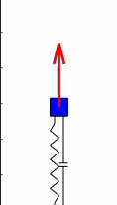




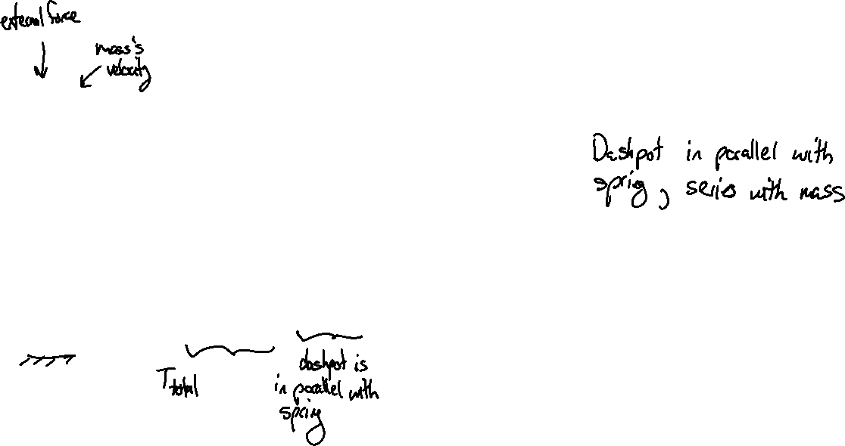
Four pole parameters for vibrations
$$\left\{\begin{matrix}{\overline{F}}_{1} \\ {\overline{v}}_{1}\end{matrix}\right\}=\left[\begin{matrix}{\overline{α}}_{11} & {\overline{α}}_{12} \\ {\overline{α}}_{21} & {\overline{α}}_{22}\end{matrix}\right]\left\{\begin{matrix}{\overline{F}}_{2} \\ {\overline{v}}_{2}\end{matrix}\right\}$$
$${\overline{F}}_{2}, {\overline{v}}_{2}$$
$\left[M\right]=\left[\begin{matrix}1 & jωm \\ 0 & 1\end{matrix}\right]$
$\left[C\right]=\left[\begin{matrix}1 & 0 \\ \frac{1}{C} & 0\end{matrix}\right]$
$\left[K\right]=\left[\begin{matrix}1 & 0 \\ \frac{jω}{k_{s}} & 0\end{matrix}\right]$
$\left[\begin{matrix}{\overline{α}}_{11} & {\overline{α}}_{12} \\ {\overline{α}}_{21} & {\overline{α}}_{22}\end{matrix}\right]=\left(\left[C\right]\right|\left|\left[K\right]\right)\left[M\right]=\left[\begin{matrix}1 & jωm \\ \frac{1}{C+\frac{k_{s}}{jω}} & \frac{jωm}{C+\frac{k_{s}}{jω}}+1\end{matrix}\right]$
$${\overline{F}}_{1}, {\overline{v}}_{1}$$

Slide 18

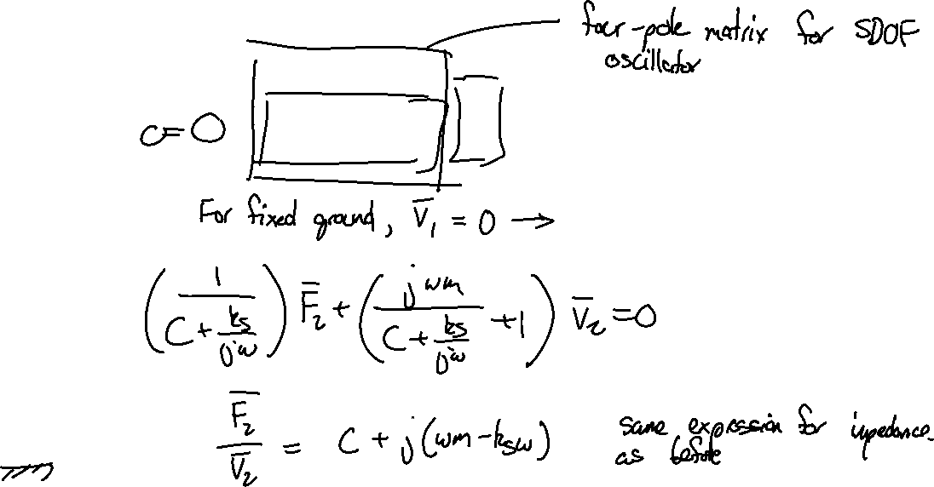
Four pole parameters for vibrations
$$\left\{\begin{matrix}{\overline{F}}_{1} \\ {\overline{v}}_{1}\end{matrix}\right\}=\left[\begin{matrix}1 & jωm \\ \frac{1}{C+\frac{k_{s}}{jω}} & \frac{jωm}{C+\frac{k_{s}}{jω}}+1\end{matrix}\right]\left\{\begin{matrix}{\overline{F}}_{2} \\ {\overline{v}}_{2}\end{matrix}\right\}$$
$${\overline{F}}_{2}, {\overline{v}}_{2}$$
$${\overline{F}}_{1}, {\overline{v}}_{1}$$

Slide 19
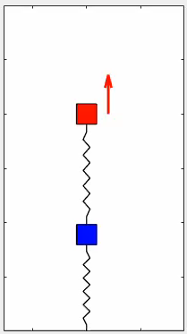


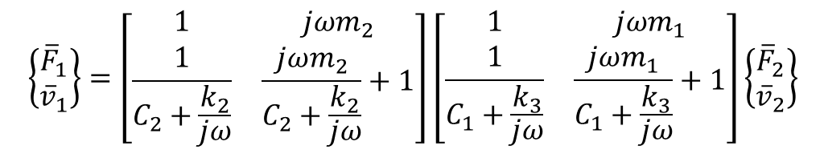

Four pole parameters for vibrations
$$\left\{\begin{matrix}{\overline{F}}_{1} \\ {\overline{v}}_{1}\end{matrix}\right\}=\left[\begin{matrix}1 & jωm_{2} \\ \frac{1}{C_{2}+\frac{k_{2}}{jω}} & \frac{jωm_{2}}{C_{2}+\frac{k_{2}}{jω}}+1\end{matrix}\right]\left[\begin{matrix}1 & jωm_{1} \\ \frac{1}{C_{1}+\frac{k_{3}}{jω}} & \frac{jωm_{1}}{C_{1}+\frac{k_{3}}{jω}}+1\end{matrix}\right]\left\{\begin{matrix}{\overline{F}}_{2} \\ {\overline{v}}_{2}\end{matrix}\right\}$$
$${\overline{F}}_{2}, {\overline{v}}_{2}$$
$${\overline{F}}_{1}, {\overline{v}}_{1}$$

Slide 20
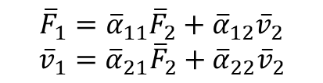
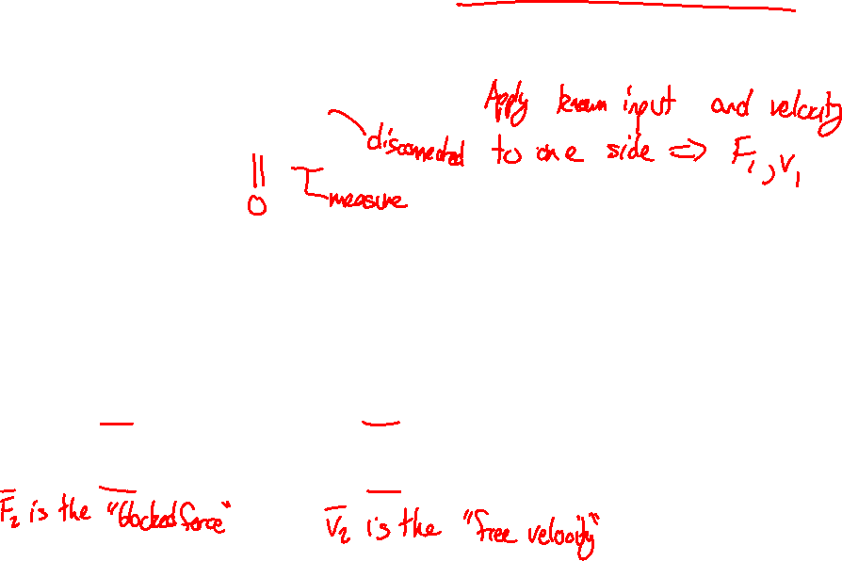


Measuring four-pole parameters for unknown components
$${\overline{F}}_{1}={\overline{α}}_{11}{\overline{F}}_{2}+{\overline{α}}_{12}{\overline{v}}_{2}$$
$${\overline{v}}_{1}={\overline{α}}_{21}{\overline{F}}_{2}+{\overline{α}}_{22}{\overline{v}}_{2}$$
$${\overline{α}}_{11}={\left[\frac{{\overline{F}}_{1}}{{\overline{F}}_{2}}\right]}_{{\overline{v}}_{2}=0}$$
$${\overline{α}}_{21}={\left[\frac{{\overline{v}}_{1}}{{\overline{F}}_{2}}\right]}_{{\overline{v}}_{2}=0}$$
$${\overline{α}}_{12}={\left[\frac{{\overline{F}}_{2}}{{\overline{v}}_{2}}\right]}_{{\overline{F}}_{2}=0}$$
$${\overline{α}}_{22}={\left[\frac{{\overline{v}}_{1}}{{\overline{v}}_{2}}\right]}_{{\overline{F}}_{2}=0}$$

Slide 21

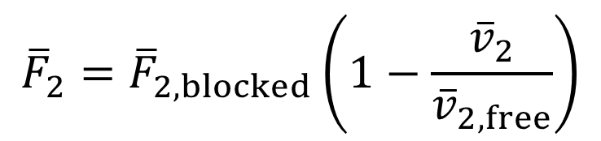
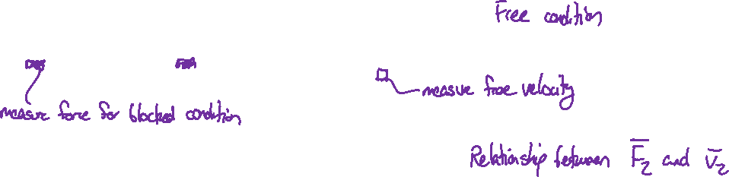
Measuring four-pole parameters for unknown components
Machine
Machine
$${\overline{F}}_{2}={\overline{F}}_{2, blocked}\left(1−\frac{{\overline{v}}_{2}}{{\overline{v}}_{2, free}}\right)$$

Slide 22
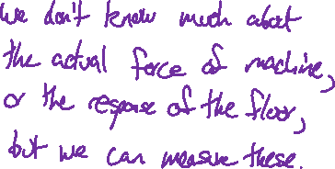
Designing a mounting system
A machine in a factory is shaking the floor and disrupting other work. Design an isolation mount to reduce the vibration of the floor.
Machine
Machine
Mount

Slide 23
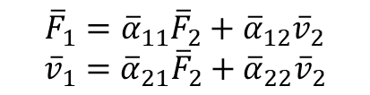
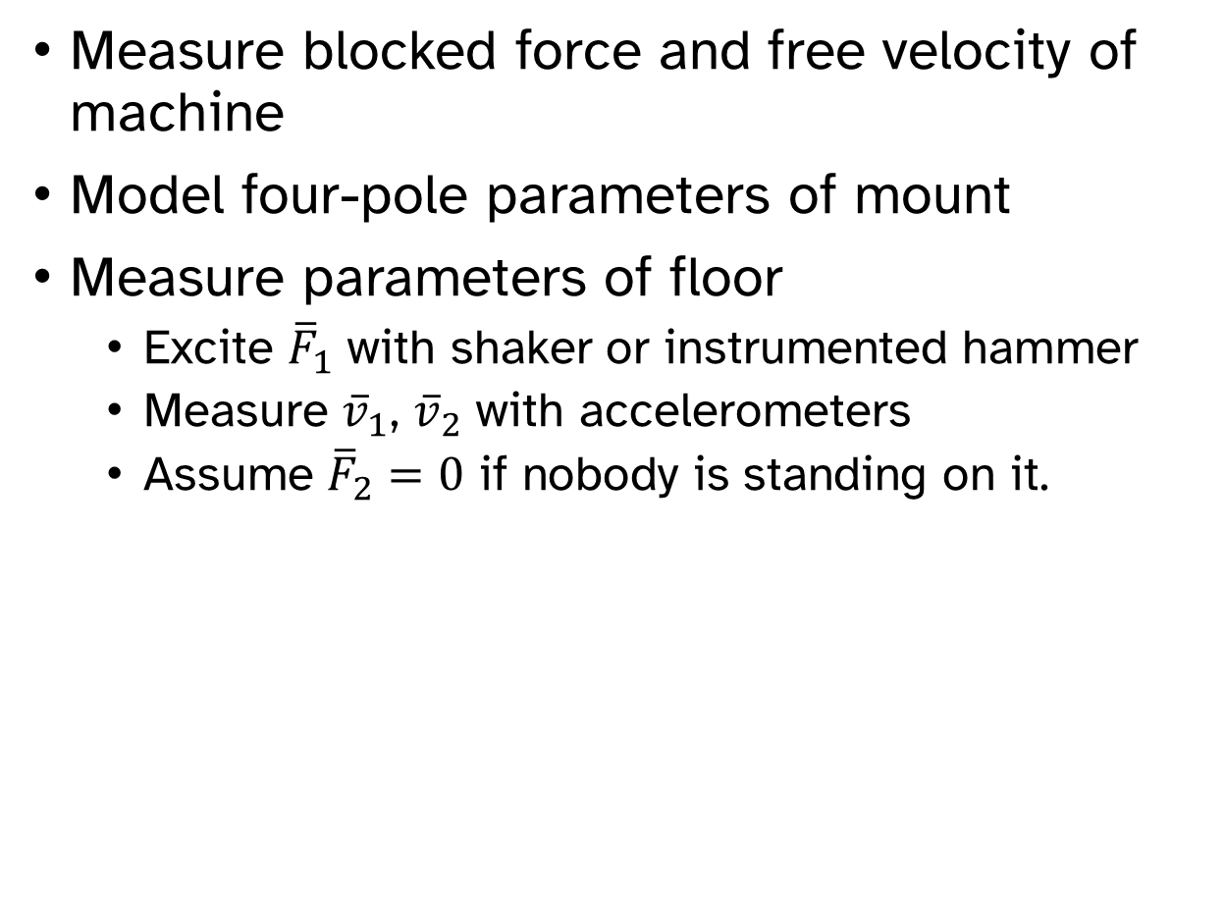
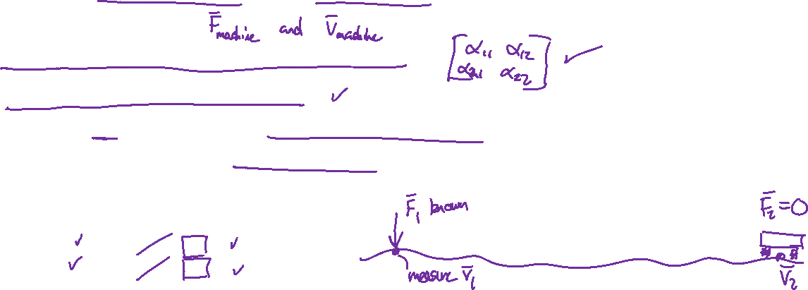
Designing a mounting system
Measure blocked force and free velocity of machine
Model four-pole parameters of mount
Measure parameters of floor
Excite ${\overline{F}}_{1}$ with shaker or instrumented hammer
Measure ${\overline{v}}_{1}$, ${\overline{v}}_{2}$ with accelerometers
Assume ${\overline{F}}_{2}=0$ if nobody is standing on it.
$${\overline{F}}_{1}={\overline{α}}_{11}{\overline{F}}_{2}+{\overline{α}}_{12}{\overline{v}}_{2}$$
$${\overline{v}}_{1}={\overline{α}}_{21}{\overline{F}}_{2}+{\overline{α}}_{22}{\overline{v}}_{2}$$

